Slide 1
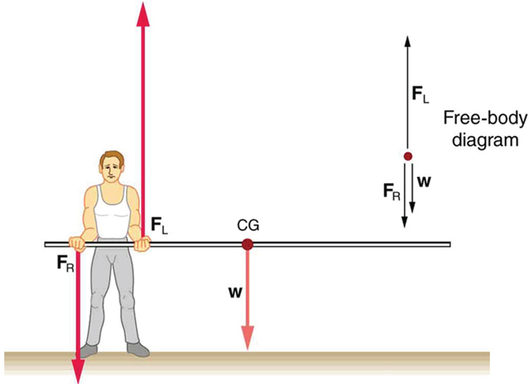
Physics 3 – Aug 23, 2018
P3 Challenge –
For the pole vaulter shown, determine the force exerted by his right and left hands on the pole to keep it horizontal if the 8.3 kg pole is 2.0 meters long, and he grips the pole with his left hand 0.50 m from the end and his right hand 0.20 m from the end.
Today’s Objectives –
Moment of Inertia
Rotational Kinetic Energy
Second Law Problems

Slide 2
Objectives/Agenda/Assignment
Objective:
B.1 Rigid bodies and rotational dynamics (1.4 – 1.5, 1.8)
Agenda:
Homework Review for #1-6
Moment of inertia
Rotational Kinetic Energy
Second Law Problems
Assignment:
Read p7-8, p10 -13 (without rolling), Do p16 #7-13 except 8 and 12

Slide 3
Moment of Inertia - derived
Consider the Kinetic Energy of an extended body. Each little incremental mass within the body has a velocity and therefore a little K.E.
The total K.E. of the body is the sum of all the incremental masses:
Total E_{K} = ½ m₁v₁² + ½ m₂v₂² + ½ m₃v₃² + ½ m₄v₄^{2 …} + ½ m_{n}v_{n}²
Substitute r_{i}ω_{i} for each velocity to put K.E. in rotational terms….
Total E_{K} = ½ m₁ r₁²ω₁ ² + ½ m₂ r₂²ω₂ ² + ½ m₃ r₃²ω₃ ² + ½ m₄ r₄²ω₄ ^{2 …} + ½ m_{n} r_{n}²ω_{n} ²
Recognize that ω the same for all points within a body and factor it out.
Total E_{K} = ½ ($\sum{m_{i}r_{i}^{2}}$) ω² Compare to E_{K} =1/2 mv² to define moment of inertia I =$\sum{m_{i}r_{i}^{2}}$.

Slide 4
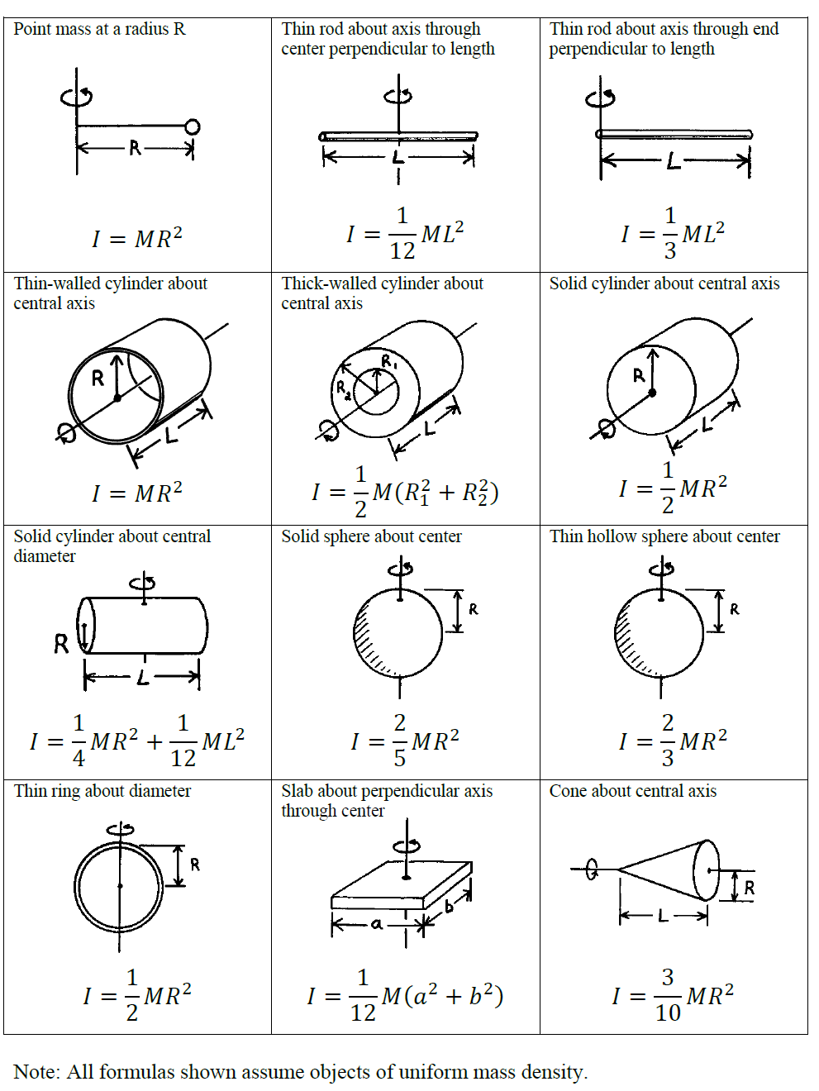
Moment of Inertia formulas
The moment of Inertia for simple shapes, depend on the geometry of the body.
Also depends on choice of axis of rotation.
You will be given the moment of inertia formulas as needed for IB.
For our tests, I will give you this image.
For complex body shapes, model with simple shapes and add their moments of inertia formulas.

Slide 5
Rotational kinetic energy
K = ½ I²
Determine the rotational kinetic energy of a 125 g solid cylinder with a radius of 32 cm rotating at 22 rad/sec about its axis of symmetry.

Slide 6
Newton’s 2nd Law, Rotational form
$Γ=Iα$
What net torque is needed to bring a 8.75 kg potters wheel disc from rest to an angular velocity of 5.35 rad/s within 3.0 seconds? The radius of the solid wheel is 0.22 m.

Slide 7
Exit slip and homework
Exit Slip – What is the moment of inertia for a baseball if it has a mass of 0.145 kg and a diameter of 7.36 cm? (Assume uniform density.)
What’s due? (homework for a homework check next class)
Read p7-8, p10 -13 (without rolling), Do p16 #7-13 except 8 and 12
What’s next? (What to read to prepare for the next class)
Read the remainder of B.1.

